Slide 1
Bio-Sensor Wearable Development Board
Carl Demolder
Date 6/07/2020

Slide 2
Outline
Project management
Introduction
Schedule
Project proposal
Block diagram
Electronics development
Firmware development
Hardware testing
Progress update
Current progress
Path forward

Slide 3
PROJECT MANAGEMENT

Slide 4
Introduction
Purpose:
Design a development board to test functionality of ‘plug-in-play’ sensors to build wearable devices in the future
Possible hardware sensors:
IMU
Heart rate and oxygen level sensor
Temperature sensor
ECG
Additional functionality:
Wireless charging and battery management circuitry
USB charging and communication
BLE Data transmission

Slide 5
Project management
Project status updates will be emailed to YSK and Dr. Yeo on a weekly basis by Monday morning (ET)
A rolling PowerPoint presentation will be used to document results and act as a final report
Each progress update will be timestamped, and the revision number will be incremented
Primary form of communication: email
Zoom/phone calls can not be conducted from 12 PM – 8 PM ET, Monday – Friday (due to my work schedule)
Project documents and resource will be available through my Github repository

Slide 6

Schedule overview
Electronics development
Date range: 6/1–9/06
Estimated work hours to produce hardware: 54 hours
Estimated work hours to test/debug/qualify hardware: TBD
Firmware development
Date range: 6/28-9/06
Estimated work hours to produce firmware: 70 hours
Estimated work hours to test/debug/qualify firmware: TBD
Any questions about the scope?
Let me know!

Slide 7
Schedule overview: hardware
PROJECT
PROPOSAL
SCHEMATIC
GENERATION
PCB COMPONENT
LAYOUT
6/1–6/7; ~5 Hours
6/7–6/14; ~24 Hours
6/14–6/17; ~5 Hours
HARDWARE
TESTING*
FULL TURNKEY
PCB MFG.
PCB ROUTING
& MFG. FILE GENERATION
7/12–7/19; 5-15 Hours
6/28–7/12; ~0 Hours
6/17–6/28; ~25 Hours
SENSOR FUNCTIONALITY TESTING*¹
POWER CONSUMPTION TESTING*¹
BLE RANGE & CONNECTION
TESTING*¹
7/26–8/16; TBD Hours
8/23–9/6; TBD Hours
8/23–9/06; TBD Hours
*Physical hardware needed to debug and perform testing.
¹Hardware functionality test of the sensors will be performed. Performance and accuracy will not be qualified. Test parameters and outline need to be defined by YSK and Dr. Yeo.

Slide 8
Schedule overview: firmware
PROJECT
PROPOSAL
PROJECT STACK
ORGANIZATION
SENSOR
DRIVERS²
7/1–6/7; ~5 Hours
6/28–7/2; ~5 Hours
7/2–7/26; ~25-35 Hours
BLE GATT
DATABASE
SENSOR FUNCTIONALITY TESTING*¹
SERIAL & RTT DATA LOGGING W/ PYTHON
8/16–8/23; ~25 Hours
7/26–8/16; TBD Hours
7/19–8/2; ~5 Hours
POWER
CONSUMPTION
TESTING*¹
8/23–9/6; TBD Hours
*Physical hardware needed to debug and perform testing.
¹Firmware functionality test of the sensors will be performed. Performance and accuracy will not be qualified.
²Sensors can be given higher priority to speed up development time.

Slide 9
PROJECT PROPOSAL: BLOCK DIAGRAM

Slide 10
Block diagram
PHERIPHERAL SENSORS
PYTHON DATA LOGGER
BLE TX/RX
IMU
TEMPERATURE
USB
RF
SERIAL TO USB CONVERTER
SERIAL
MCU/SoC
SERIAL
ECG
POWER
HR/Sp0₂
LIPO BATTERY
POWER
BMS
BATTERY GAUGE
POWER
WIRELESS
CHARGING COIL
POWER
WIRELESS CHARGING CIRCUITRY

Slide 11
PROJECT PROPOSAL: POWER CONSUMPTION TESTING

Slide 12
Power consumption testing [TBD]
Objective: Measure the power consumption of various sensors during operation, idle, and sleep mode
Log battery current and voltage at a defined sampling rate
Produce a power consumption model to determine battery life

Slide 13
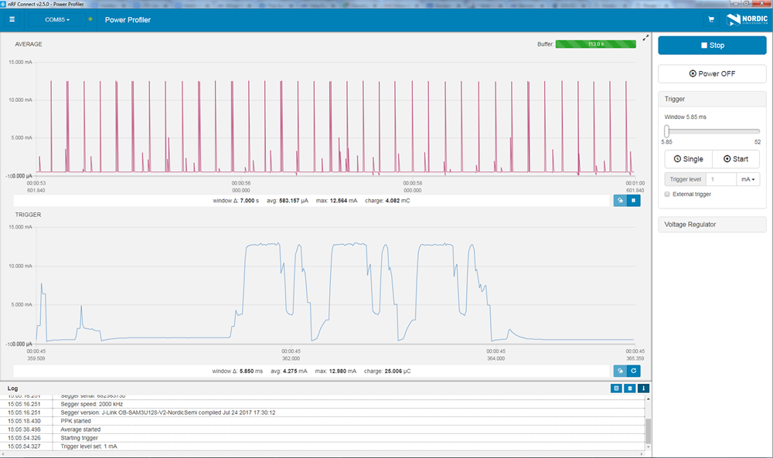
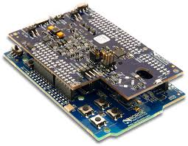
Power consumption testing [TBD]
Nordic power profiler
Nano-amp resolution, fast sampling rate
See spikes of BLE transmission

Slide 14
PROGRESS TO DATE

Slide 15
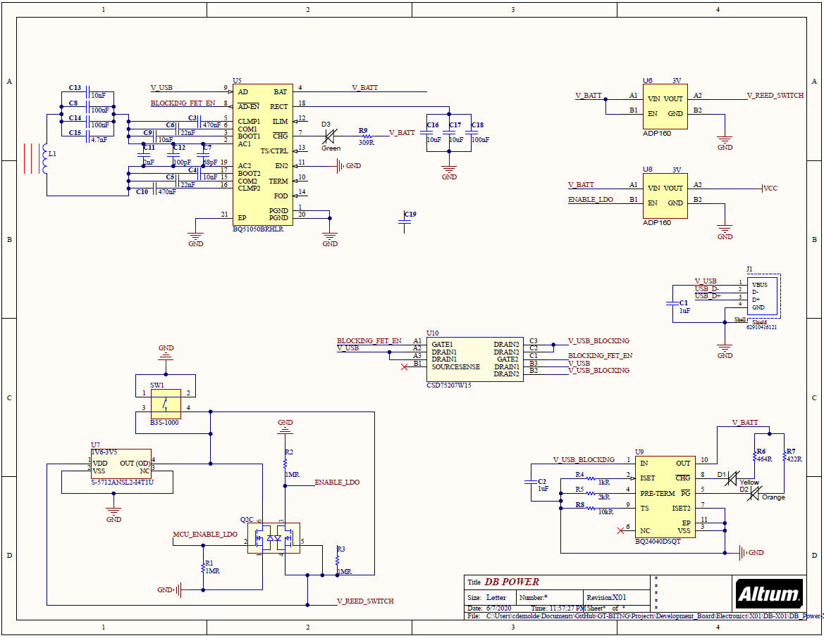
Progress to date: 6/8/2020

Slide 16
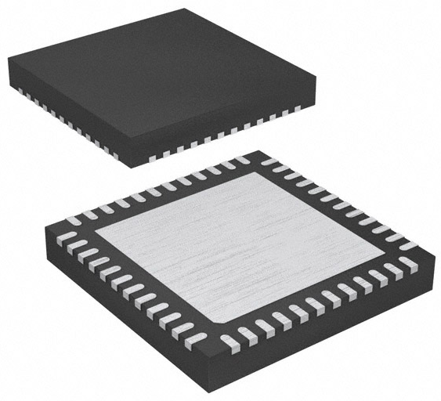
Component selection: MCU/BLE
MCU/BLE: nRF52832
6 pin, 2.00 mm x 2.00 mm, WSON-6
±0.1°C from -20°C to +50°C
2.4 GHz BLE
Power = 4 dBm
Sensitivity = -96 dBm
RAM = 64 kB, flash = 512 kB
Serial interfaces: I²C, UART, SPI
Supply voltage: 1.7V ~ 3.6V
$5.46 [X1], 1490-1067-1-ND, LINK
nRF52832

Slide 17
Component selection: clocks
HF clock: US3200005Z
4 pin, 1.60 mm x 1.20 mm, 4-SMD
32.00 MHz, 8 pF, ±10 ppm
$1.45 [X1], US3200005ZCT-ND, LINK
LF clock: ECX-1210
1210 package, 1.20 mm x 1.00 mm, 2-SMD
32.7680 kHz, 9 pF, ±20 ppm
$1.52 [X1], XC2283CT-ND, LINK
US3200005Z
ECX-1210

Slide 18
Component selection: USB/Serial
USB connector: 62910416121
4 pin, 16.00 mm x 10.62 mm, SMT type B
USB TYPE-B, USB 2.0, right angle
$3.83 [X1], 732-3152-1-ND, LINK
USB/I²C converter: FTDI FT201XQ-R
16 pin, 4.0 mm x 4.0 mm, 16-QFN
USB to I²C converter
3.4 Mbit/s
Low power consumption (8 mA)
$2.04 [X1], 768-1131-1-ND, LINK
62910416121
FT201XQ-R

Slide 19
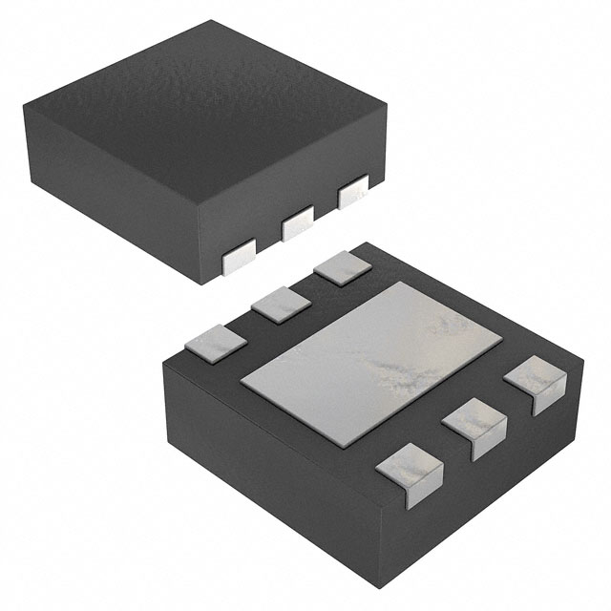
Component selection: Bio-sensors
Temperature: TI TMP117
6 pin, 2.00 mm x 2.00 mm, WSON-6
±0.1°C from -20°C to +50°C
16-bit resolution: 0.0078 °C, I²C
$8.02 [X1], 296-51834-1-ND, LINK
IMU: TI BQ27621-G1
14 pin, 2.5 mm x 3.0 mm, 14-LGA
I²C communication
9-axis, 16-bit resolution
Full operation mode = 925 uA
$4.98 [X1], 828-1057-1-ND, LINK
TMP117
BMI160

Slide 20
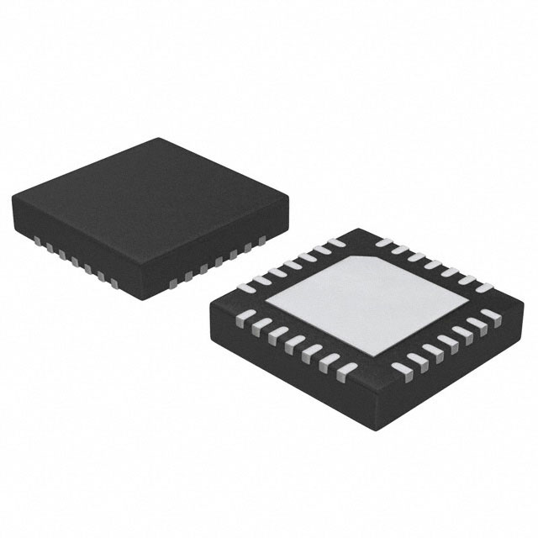
Component selection: Bio-sensors
H.R. & Sp0₂: MAX30102
14 pin, 5.6 mm x 3.3 mm, 14-OESIP
Pulse oximetry and heart-rate
Temperature comepensation, I²C
$9.51 [X1], MAX30102EFD+-ND, LINK
ECG: MAX30003
28 pin, 5.0 mm x 5.0 mm, 28-TQFN
SPI communication
15.5-bit resolution
Ultra-low power, single-channel integrated
$8.21 [X1], MAX30003CTI+-ND, LINK
MAX30102
MAX30003

Slide 21
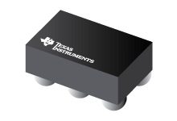
Component selection: wireless charging
Wireless charging IC: TI BQ51003
28 pin, 1.90 mm x 3.00 mm
QI v1.2 communication protocol
93% AC-DC efficiency
$3.00 [X1], 296-39952-1-ND, LINK
LiPo battery charger IC: TI BQ25100
6 pin, 1.6 mm x 0.90 mm, 4.2V 1 cell
1% Charge voltage accuracy
10 mA to 250 mA charging current
$2.24 [X1], 296-38373-1-ND, LINK
BQ51003
BQ25100

Slide 22
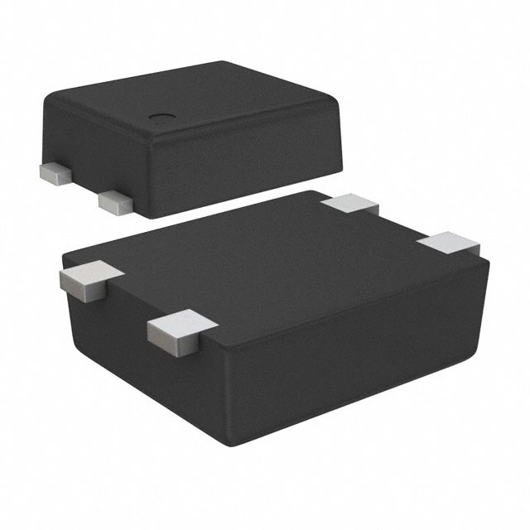
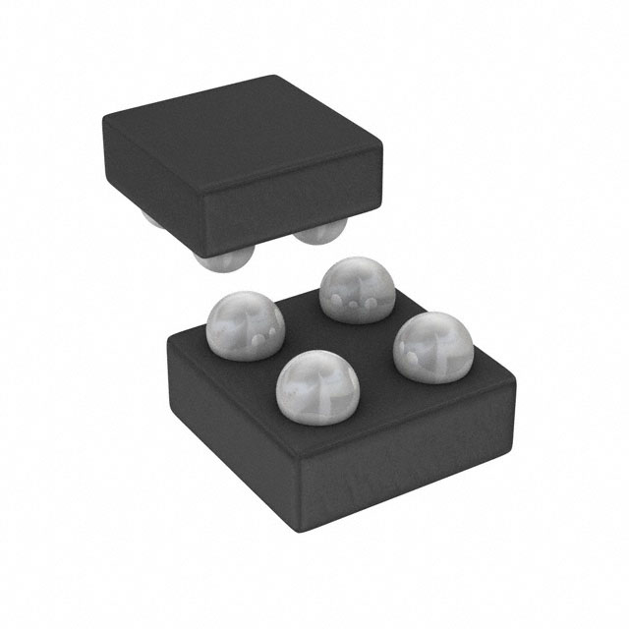
Component selection: power circuit
Reed Switch: ABLIC S-5712A
4 pin, 1.90 mm x 3.00 mm, SNT-4A
Non-contact ‘power switch’
High accuracy hall effect switch IC
$1.07 [X1], 1662-1617-1-ND, LINK
Linear Regulator: Analog Devices ADP172
4 pin, 0.95 mm x 1.03 mm, 4-WLCSP
0.1V dropout voltage
300 mA max current
$1.09 [X1], ADP172ACBZ-3.0-R7CT-ND, LINK
S-5712A
ADP172

Slide 23
Component selection: power circuit
Charging coil: Wurth 760308101219
1 coil, 1 layer, D=15 mm, H=0.6 mm
11.8 uH, 750 mΩ, t = ±10%
$7.43 [X1], 732-9675-ND, LINK
Fuel gauge: TI BQ27621-G1
9 pin, 1.62 mm x 1.58 mm, 9-DSBGA, 0.5 mm pitch
I²C communication
Dynamic voltage correlation algorithm
Battery capacity, state-of-charge, voltage
$2.21 [X1], 296-37460-1-ND, LINK
760308101219
BQ27621-G1

Slide 24
Component selection: TBD
Components still need to be selected:
BLE antenna
BLE impedance matching circuit/filter
DCDC circuit

Slide 25
PATH FORWARD

Slide 26
Path forward (6/7/20 – 6/14/20)
Finish the schematic
Wireless and USB charging and battery monitoring
Digital communication to peripheral sensors
Connectors (USB, J-Link, test points, jumpers, ECG, etc…)
Bluetooth transmission
MCU clocks and supporting MCU circuitry
USB communication
Summit to YSK and Dr. Yeo for review: 6/14/20

Slide 27
Possible functionality
Possible functionality:
Local data storage? (SD Card, EEPROM, etc…)
Type of ECG connector? (Digikey part number…)
NFC?
Any other ideas?

